Slide 1
Intro to Biotech
Lect.3
What is the evidence that Genes = DNA?
Robert Feulgen –

Slide 2
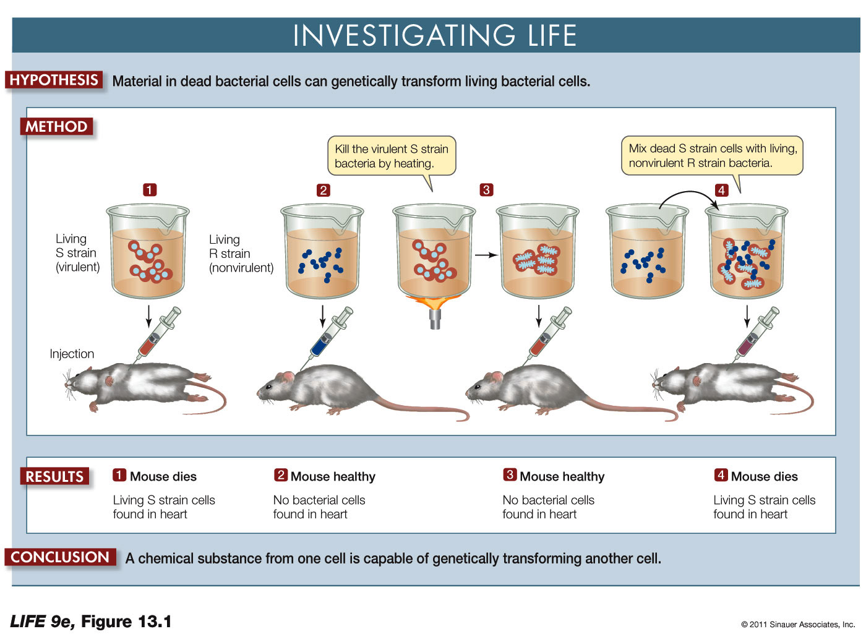
Intro to Biotech
Lect.3
What is the composition of a gene?
Traits can be transferred:
1928 Griffith & Streptococcus pneumonia
What is the chemical nature of this heritable change?
How can we determine what a gene is?
1944 Avery - experimental system?

Slide 3
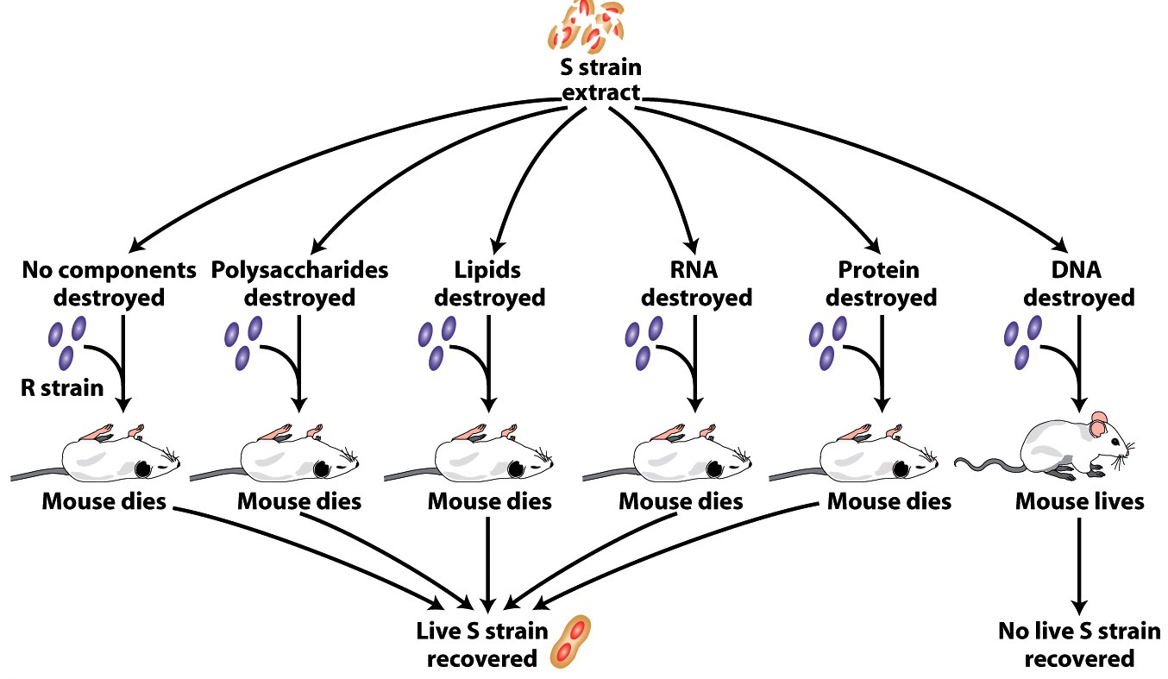
Intro to Biotech
Lect.3
What is the composition of a gene?
• 1944 Avery - experimental system?
1.
2.
3.
4.
5.
Take home = Gene comprised of DNA
DNA fulfills key properties of hereditary material

Slide 4
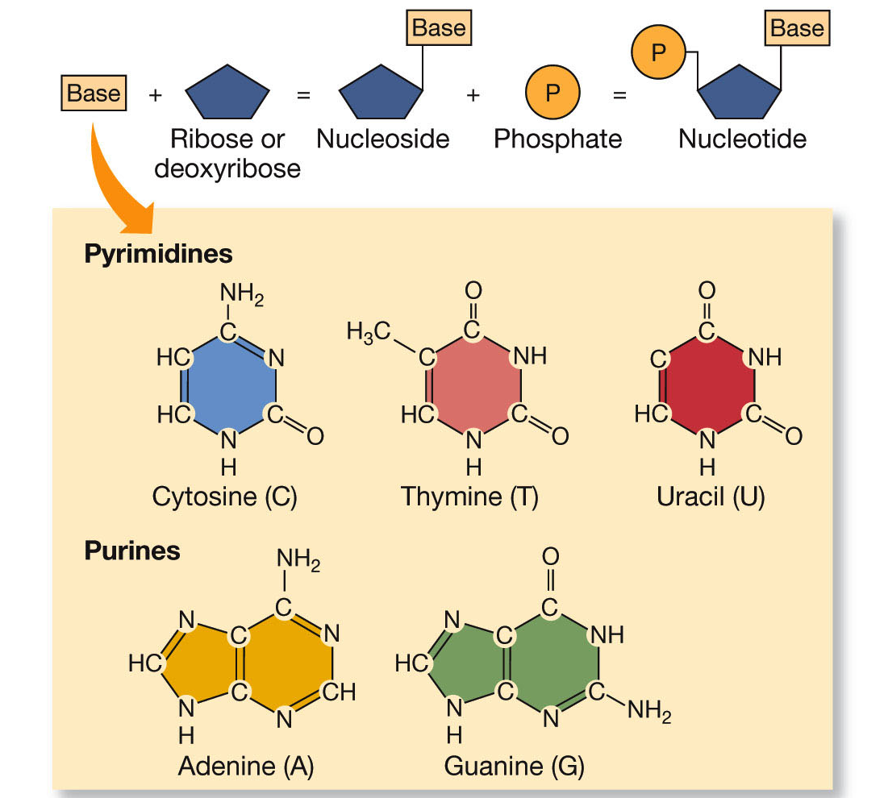
Lect.2
Intro to Biotech
Lect.3
What is DNA - “deoxyribonucleic acid”
Chargaff’s rules
1.
2.

Slide 5
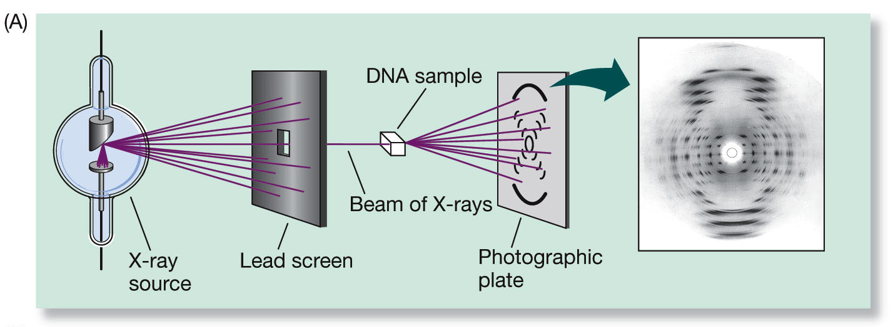
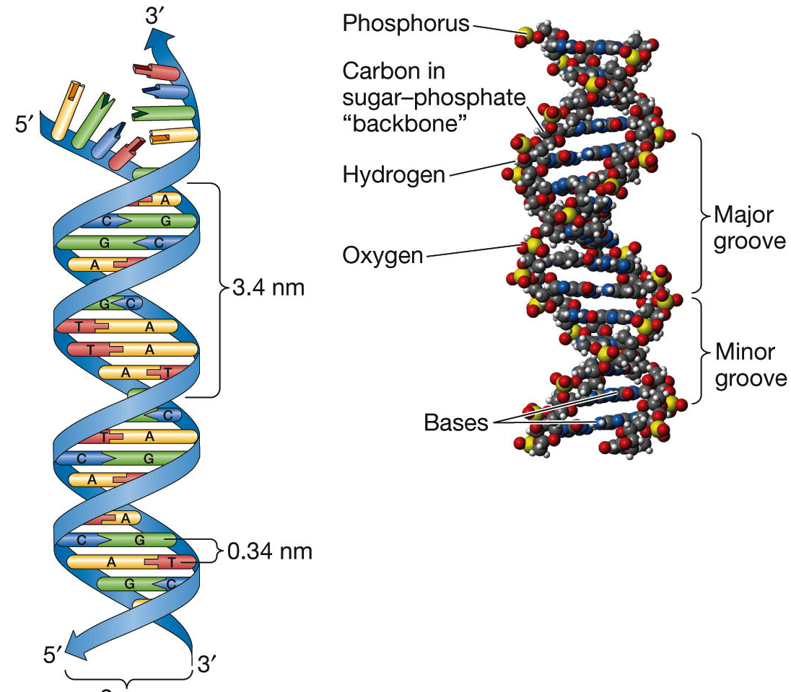
Lect.2
Intro to Biotech
Lect.3
What is DNA – Structure??
Pure molecule – crystals – diffraction of X rays –
infer position of atoms = structure
•

Slide 6


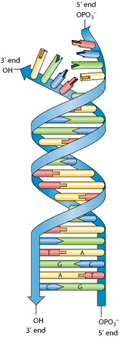
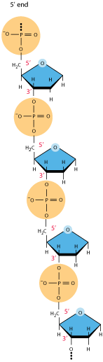
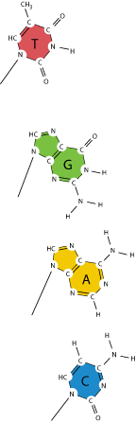
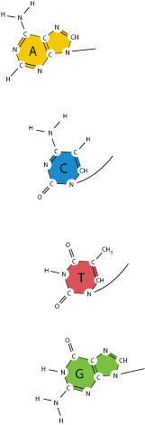
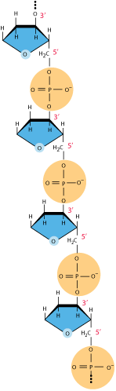
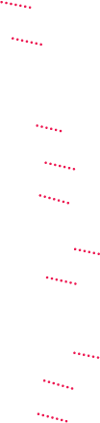

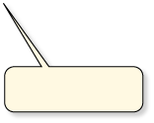

Lect.2
Intro to Biotech
Lect.3
What is DNA – Structure??
Phosphodiester linkage
Complementary (A=T, C=G)
3′ end
TA pairs have two
hydrogen bonds.
CG pairs have three hydrogen bonds.
3′ end
5′ end

Slide 7
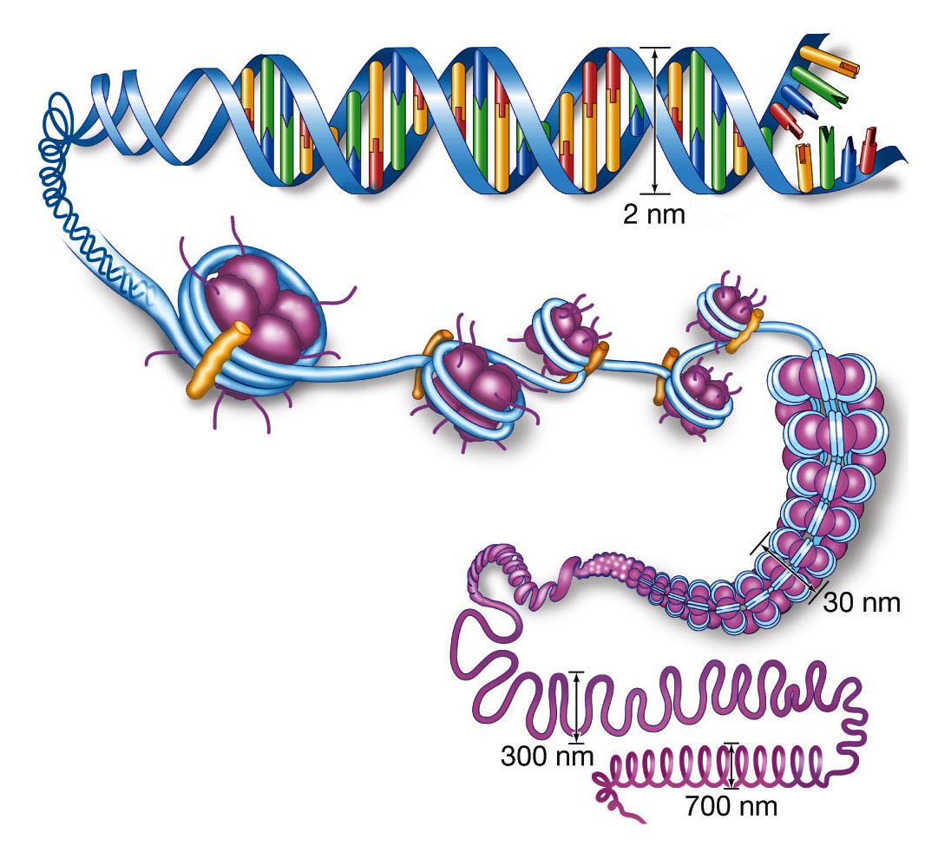
Lect.2
Intro to Biotech
Lect.3
What is DNA – Structure??
Chromatin –
• histones
Does DNA structure fulfill requirements?
1. faithful replication complementarity
2. informational content sequence
3. variation mutation/cross-overs

Slide 8
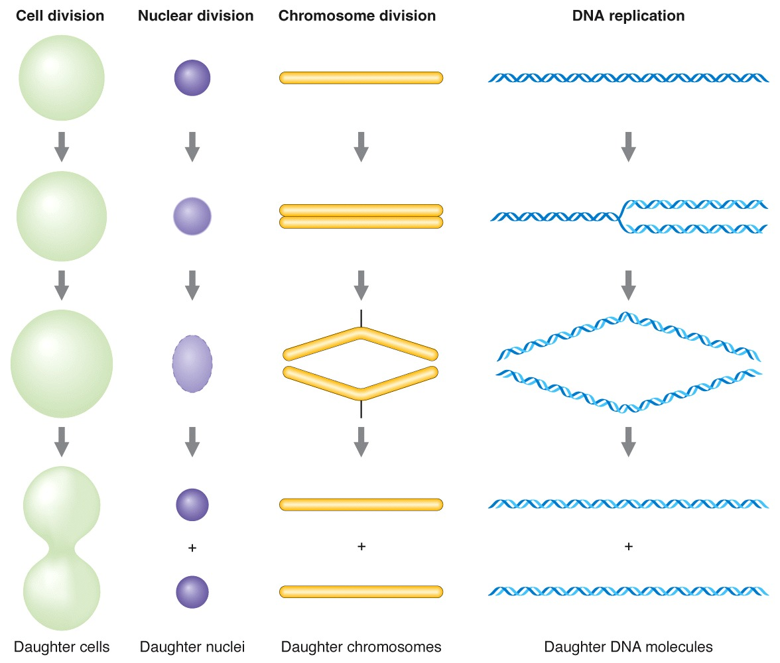
Lect.2
Intro to Biotech
Lect.3
Heredity genes = DNA
Requires

Slide 9
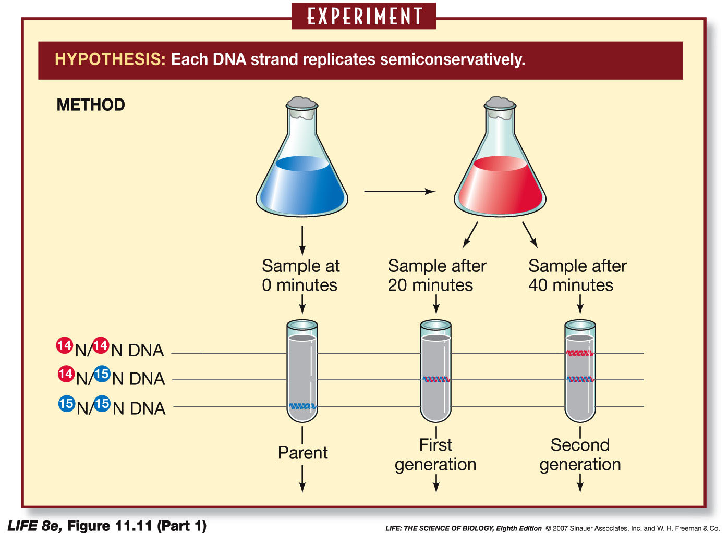
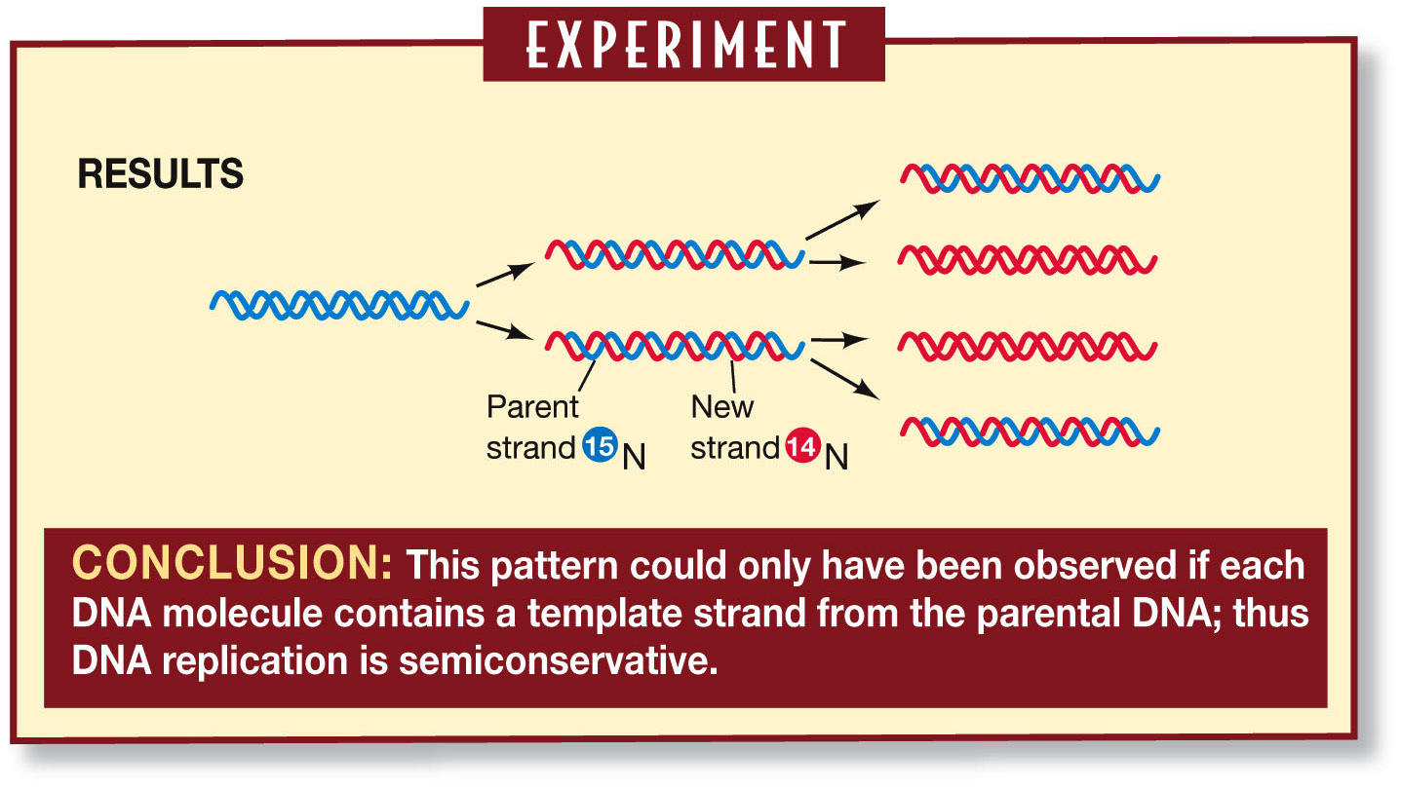
Intro to Biotech
Lect.3
What are the molecular underpinnings of heredity?
Faithful replication - molecular mechanism?
How is DNA propagated?
Semiconservative
replication

Slide 10
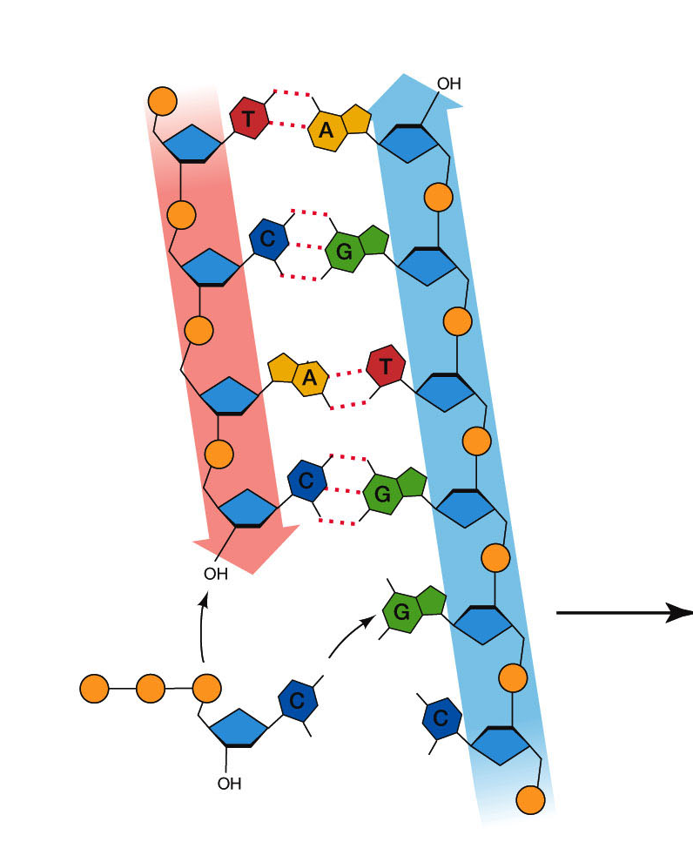
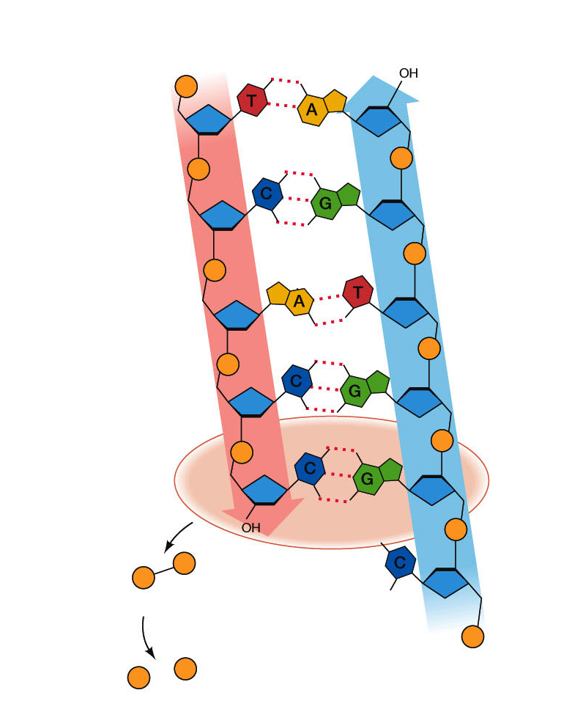
Intro to Biotech
Lect.3
How is DNA propagated ?
Semiconservative
replication
5′ end
3′ end
3′ end
5′ end
phosphate ions

Slide 11
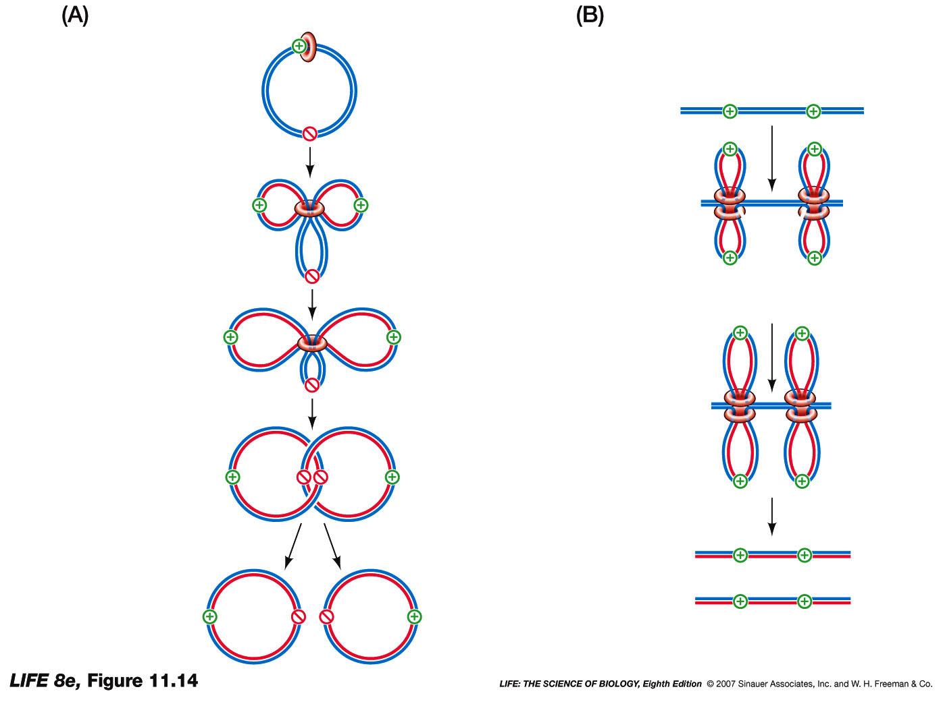
Intro to Biotech
Lect.3
How is DNA propagated ?
Semiconservative
replication
Prokaryotic
Eukaryotic
Circular chromosome
-
linear chromosome
-
Circular chromosome
-
linear chromosome
-
Topoisomerase
- telomere??
Rate of replication?
Size of Genome?
1000nts/sec
4.7Mbs vs 3.4Gbs
E. coli H. sapiens
Length of time to replicate genome?

Slide 12
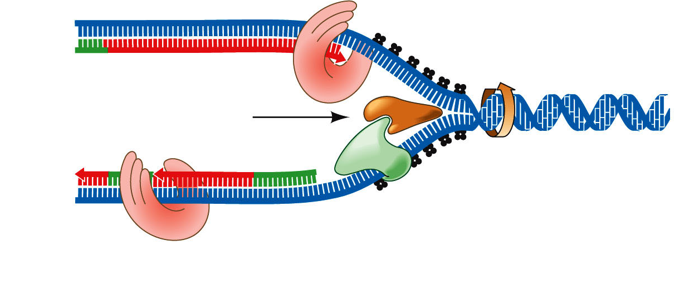
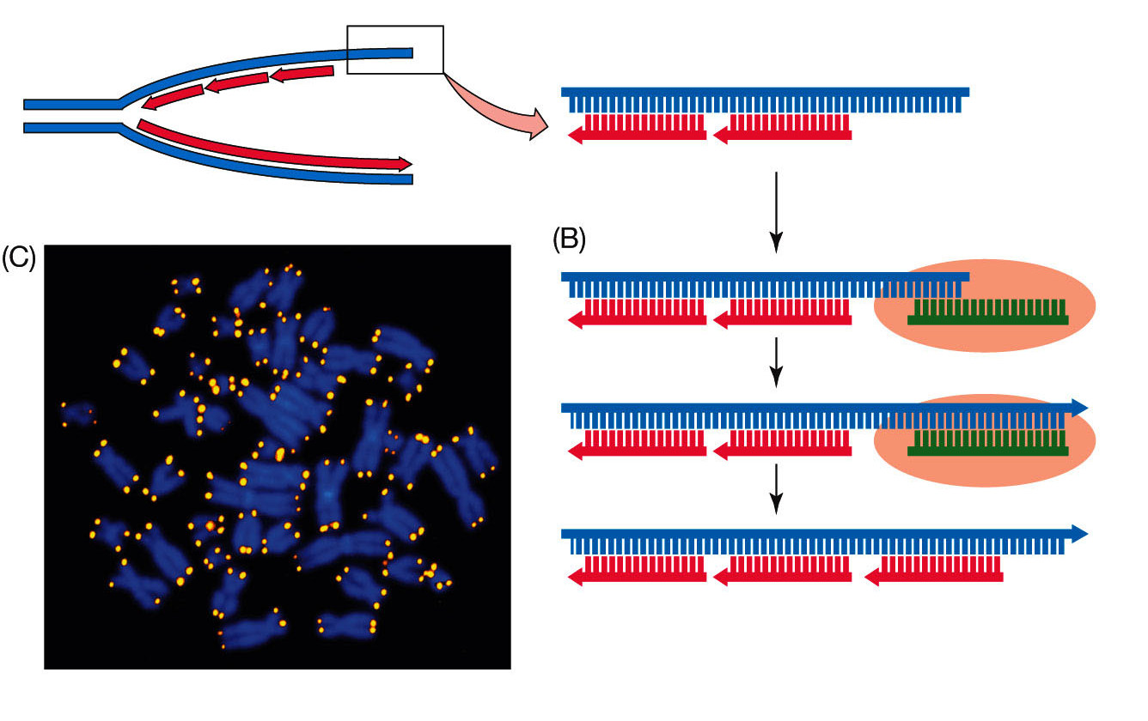
Intro to Biotech
Lect.3
How is DNA propagated ?
Semiconservative
replication
Leading strand template
3′
1.
5′
Parent DNA
Leading strand
3′
Lagging strand
5′
3′
5′
2.
Okazaki
fragment
RNA
primer
Lagging strand template
3.
4.
5.
6.
TTAGGG (2500X)
Telomerase:
RNA + protein
No Telomerase =

Slide 13
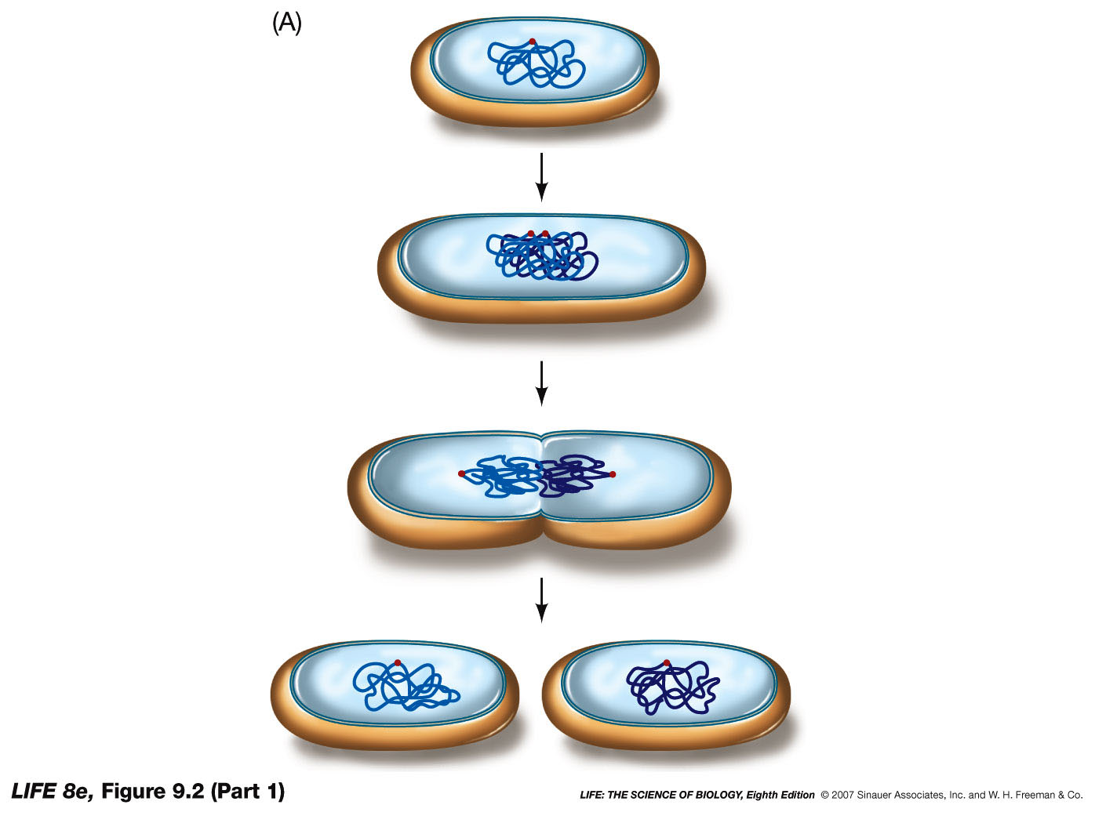
Intro to Biotech
Lect.3
How is DNA propagated ?
1. Replication
2. Segregation
3. Cytokinesis
Prokaryotic
Eukaryotic
Reproduction
Growth
Regeneration/Repair

Slide 14
Intro to Biotech
Lect.3
How is DNA propagated ?
1. Replication
2. Segregation
3. Cytokinesis
Importance of cytoskeleton!

Slide 15
Intro to Biotech
Lect.3
How is DNA propagated ?
Fidelity of replication: if 1/10⁵ = 60,000 mutations/division
How prevent?
1.
2.
3.
- mutations = XP
- increased incidence of cancer
- <40% survive past 20yrs old
Biotechnology
How might knowledge of replication be useful?
3′
5′
Parent DNA
Leading strand
3′
Lagging strand
5′
3′
5′

Slide 16
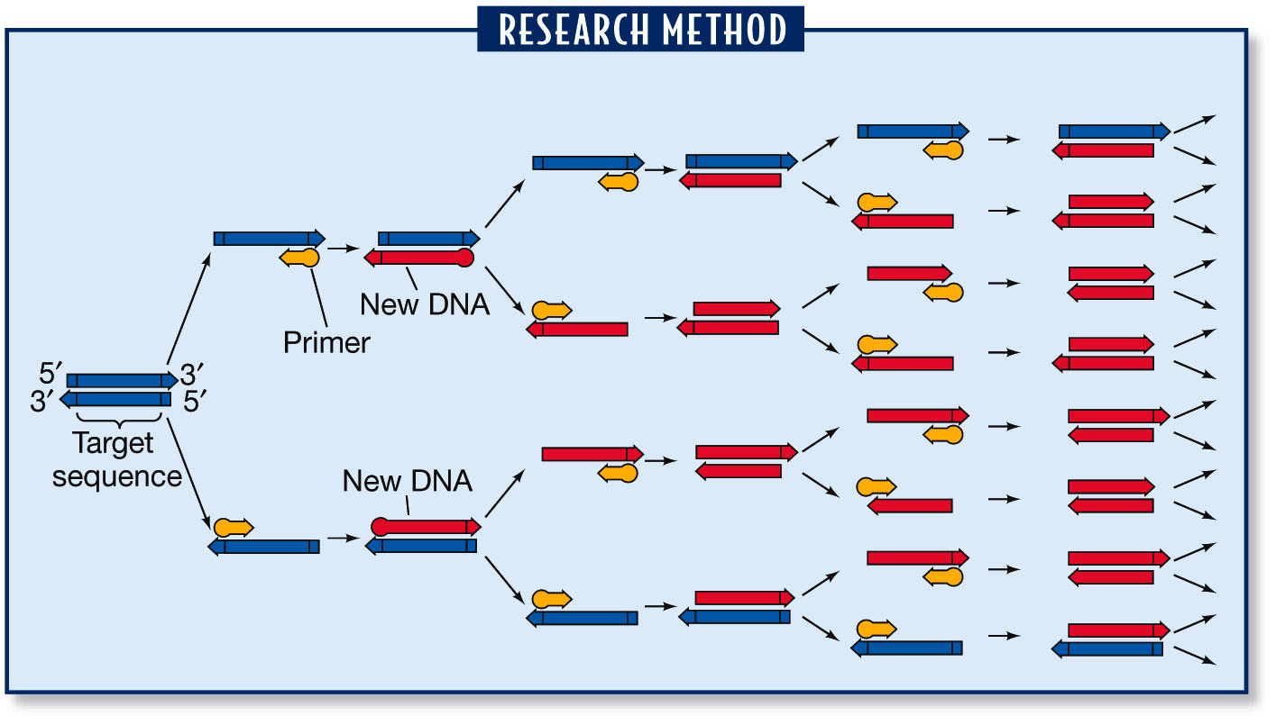
Intro to Biotech
Lect.3
How is DNA propagated ?
Biotechnology
How might knowledge of replication be useful?
• Uses ???
• Uses ???
PCR - What is needed for DNA Replication?
Polymerase Chain Reaction
1.
2.
3.
4. ???

Slide 17
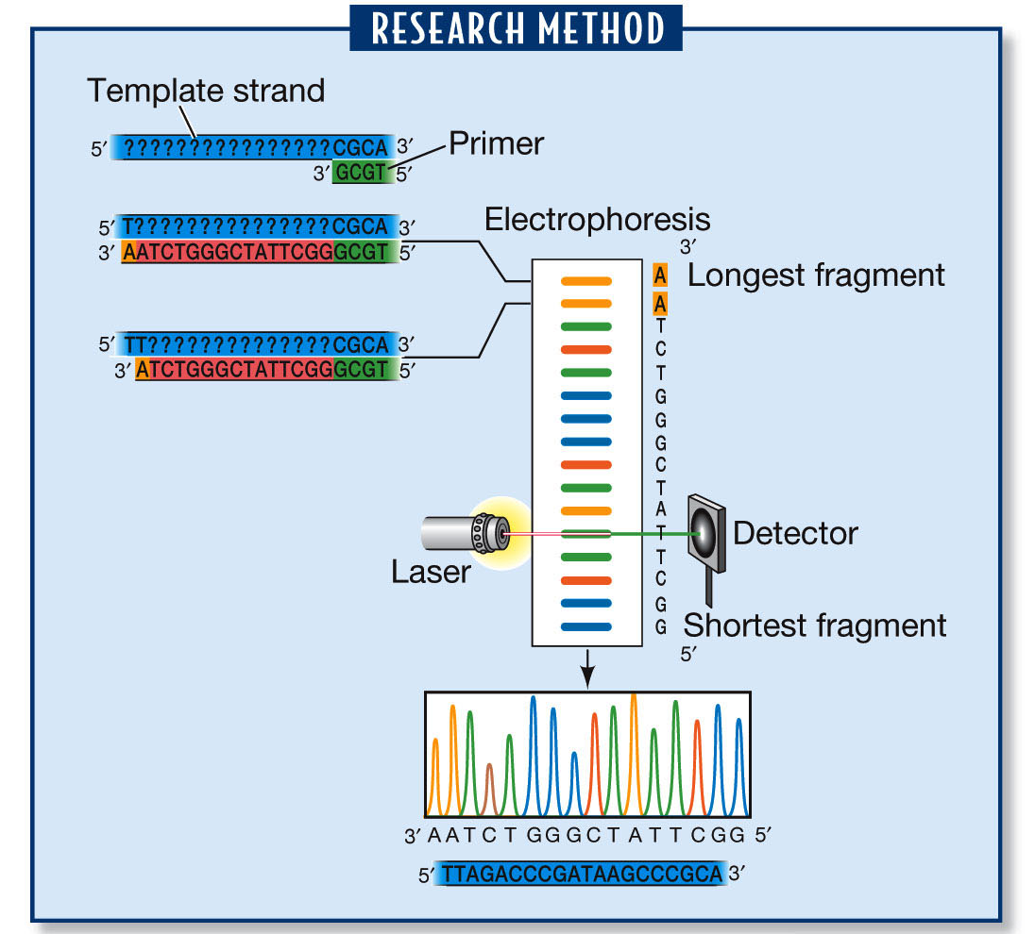
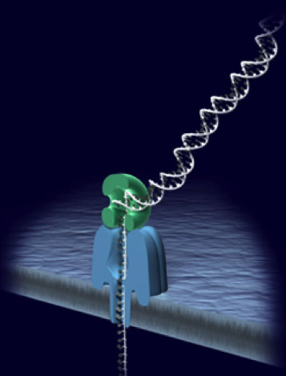
Intro to Biotech
Lect.3
Biotechnology
How might knowledge of replication be useful?
DNA sequencing

Slide 18
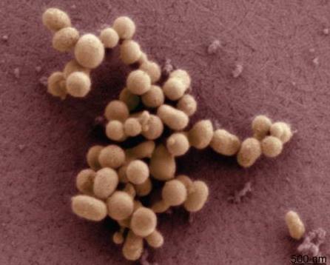
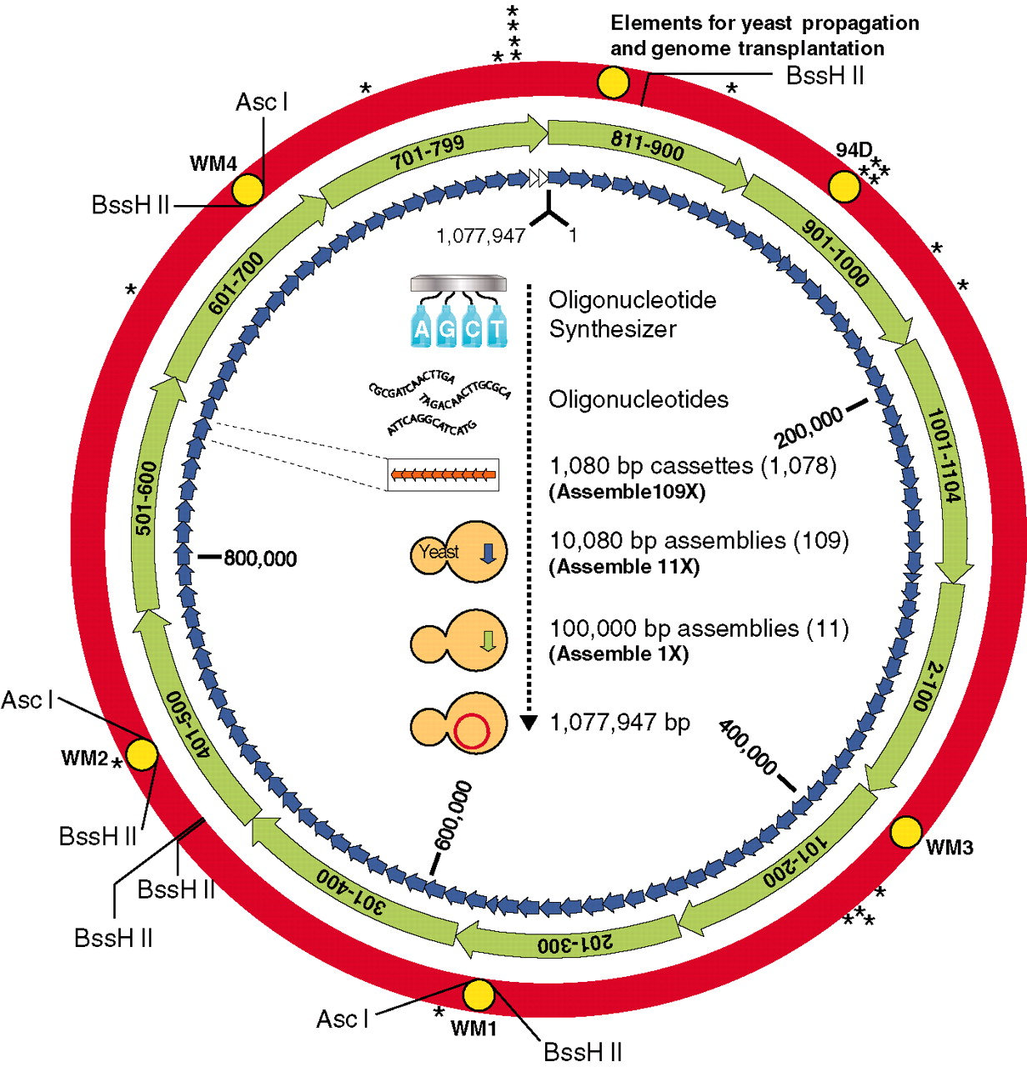
Intro to Biotech
Lect.3
Biotechnology
How might knowledge of replication be useful?
Mycoplasma mycoides JCVI-syn1.0
Synthetic genomes

